Slide 1


Microsoft® Lync™ 2010
Conferencing and Collaboration
Training

Slide 2
Objectives
In this course you will learn how to:
Get Set up for Online Meetings
Dial in conferencing and Personal ID
Schedule an Online Meeting
Multiparty/multi-platform meetings using Lync and Outlook
Deliver a Professional Presentation
Formal presentations using Screen Sharing, PowerPoint, and Whiteboard
Work with Anyone Anywhere
Collaboration with colleagues no matter where they are
Use Microsoft Lync Attendee_x000b_Join online meetings even if you don’t have Lync installed

Slide 3

Getting Set up for Online Meetings
This section covers the following:
Dial-in Conferencing
Set up your Personal Identification Number PIN
BACK TO OBJECTIVES

Slide 4
Understanding Dial-in Conferencing
Dial-in Conferencing
Dial-in Conferencing is an audio option for online meetings that allows participants, inside or outside your organization, to join the meeting audio using a phone.
Your participants can just dial the number in your meeting invitation, enter the Conference ID and join the audio.
Personal Identification Number (PIN)
If you are not on your corporate Network and want to dial in to a meeting using a phone, as a leader or authenticated caller, you’ll need your extension and Personal Identification Number (PIN).
An Authenticated caller is a user on the same enterprise as the meeting organizer or federated with the enterprise. Each user within your company can join as an Authenticated caller using their PIN and extension.
When you use your PIN, you are identified and authenticated and your name will show in the Participant List along with your role.
Note: If you don’t use your PIN, you can still dial-in to the meeting, but you will not be authenticated or able to start the call as the leader.
BACK TO OBJECTIVES

Slide 5


Set up Your Personal Identification Number
Access the PIN settings page by doing one of the following:
    Open Lync , click the drop down menu next to the Options button, and then click Tools, Dial-in Conferencing Settings.
    Open Lync and click the Phone then click PIN
    View your PIN Settings
On the PIN setting page, under Personal Identification Number, click Sign In.
In the Language list, click your preferred language, and then click Sign In.
On the Create New PIN page, click PIN or Change PIN.
Type a number that meets the PIN requirements in the PIN text box, and then retype your new PIN in the Confirm PIN text box. When you are finished, click OK.
NOTE: You must be on your corporate network to set up your PIN.
BACK TO OBJECTIVES

Slide 6
Dial-in Conferencing Settings
On the Dial-in Conferencing Settings page, note other helpful information such as:
Assigned Conference Information
  This information is your Assigned Conference ID and Meeting URL that populates automatically in your meeting invitation when you schedule a meeting via Outlook Add-in. Please note that you can reset your assigned conferencing information using the link provided on the page.
Conference Dial-in Numbers
Your participants can use this list to find phone numbers that are local to their location.
In Conference DTMF Controls (Dual-tone multi-frequency signaling or Touch Tone)
  Use these touch tone commands to control features in your meeting such as mute, unmute, lock, unlock, etc.

Slide 7
Schedule an Online Meeting
This section covers the following:
Schedule an Online Meeting using Outlook
Select your Meeting Options
Select your Audio Options
BACK TO OBJECTIVES

Slide 8
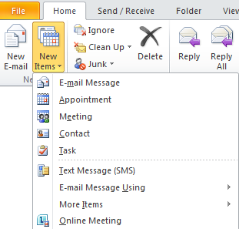
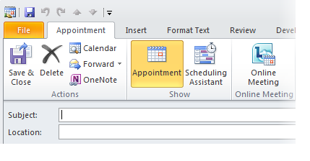
Schedule an Online Meeting
The Online Meeting Add-in for Microsoft Outlook is installed automatically when you install Lync .
Use one of the following options to schedule an online meeting:
  On the Home tab in Outlook, click New Items, and then click Online Meeting. Go to Calendar view in Outlook and click New Online Meeting on the Outlook ribbon to schedule your meeting.
  OR
  In Calendar view, double-click the time you want to have the meeting. Click Online Meeting in the toolbar.
Online Meeting
BACK TO OBJECTIVES

Slide 9
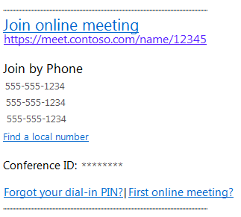
The Meeting Invitation
An Online meeting invitation opens with the following information included:
  Join online meeting link
  Audio information
  Conference ID
  PIN reset option
  Help for first-time users
Note: You can add your meeting agenda above or below the dotted lines in the invitation. Don’t change the meeting information between the dotted lines, as it may prevent your people from joining your meeting.
BACK TO OBJECTIVES

Slide 10

Customize Your Meeting Options
If you want to change the default meeting options, click Meeting Options on the Outlook ribbon to customize Access Level, Presenters and Audio options.
  Select Customize access and presenters for this meeting. Please note that by selecting this option, you will have a new meeting link and conference ID.
Under Access & Presenter section, select the options as appropriate. The options are cover in detail in this section.
BACK TO OBJECTIVES

Slide 11
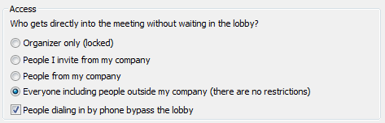
Customize Access to the Meeting
  Choose who can login to your meeting without waiting in the meeting lobby. The lobby is a virtual waiting place and only the organizer and presenters can choose who to admit from the lobby. Under Access section, select one of the following:
Organizer only (locked): Only the organizer of the meeting will login directly into the meeting without waiting in the lobby.
People I invite from my company: Only people you have invited that are authenticated on your corporate network will bypass the lobby.
People from my company: Anyone on your corporate network who has the meeting link can directly access the meeting without waiting in the lobby.
Everyone including people outside my company (there are no restrictions): Anyone who has your meeting link can bypass the lobby.
People dialing in by phone bypass the lobby: Anyone who has dialed in to the meeting from a phone can bypass the lobby (except when the meeting is locked).
Access Options
BACK TO OBJECTIVES

Slide 12
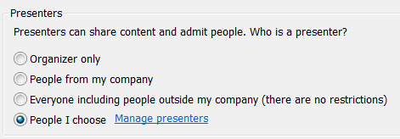
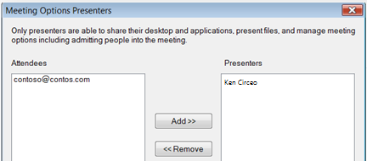
Customize Presenter Options
By default only presenters and organizers can share their desktop and applications, present files, and manage meeting options- including admitting people into the meeting. Under Presenters section, select one of the following:
Organizer only: Only the organizer of the meeting can share content and admit people from the lobby.
People from my company: Anyone from your company will be able to share content and admit people from the lobby.
Everyone including people outside my company (there are no restrictions): Everyone, including people who are not from your company and aren’t authenticated, will be able to share content and admit people from the lobby.
People I choose: To choose specific people to be presenters, click Manage presenter, and then add people you are inviting to the Presenters list.
Note: You can also promote attendees to be presenters, and demote back to attendee during the meeting. Right click an attendee name in the People pane in your meeting, then click Make a Presenter.
BACK TO OBJECTIVES

Slide 13
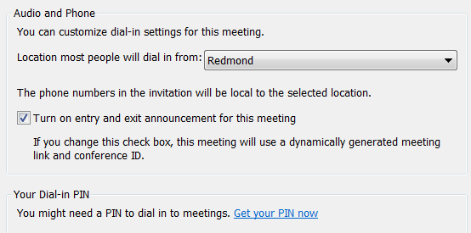
Customize Audio Options
To customize the Audio Options, click the Audio & Phone tab on Meeting Options window.
Select the location most of your participants will dial-in from
If you need to reset your PIN, click Get your PIN to go to the Dial-in Conferencing Settings and PIN Management page.
If you want to enable entry/exit announcement, check the box next to turn on entry/exit announcements for this meeting.
Note: You can also change the entry/exit announcement option during the meeting.
BACK TO OBJECTIVES

Slide 14
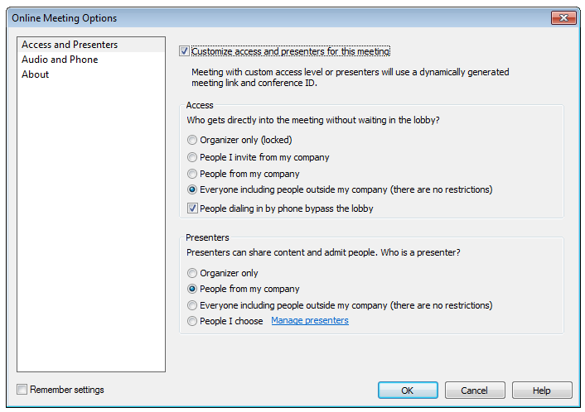
Save Your Customized Settings
You can save your preferred settings so that your future meetings use the same settings by default.
Click Remember settings.
Click OK.
Remember Settings
BACK TO OBJECTIVES

Slide 15
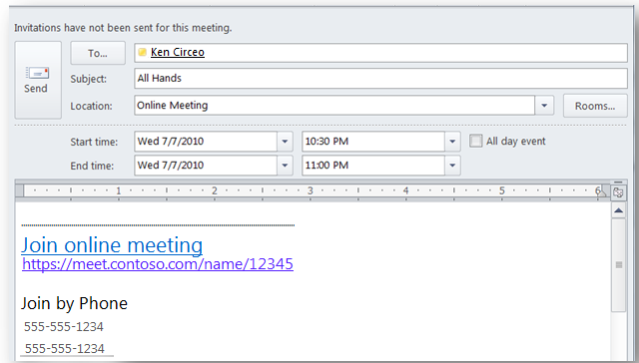
Send Your Invitation
After you are done setting up the meeting options you can add your attendees, verify you have the correct date and time and then send the invitation.
The meeting request will appear on your calendar and invitations are sent to your attendees.
BACK TO OBJECTIVES

Slide 16
Activity 1
Schedule a meeting using Outlook and set the roles and permissions.
Open Outlook and go to calendar view.
Click New Online Meeting on the Outlook ribbon.
Type a meeting subject, and then select date and time and participants.
Click Meeting Options on the Outlook ribbon and then click Customize access and presenters for this meeting.
Under Access, choose who can join your meeting without waiting in the lobby.
Under Presenters, select People I choose, then click Manage Presenters and add the presenters.
Click OK when you are done and then send your invitation.
BACK TO OBJECTIVES

Slide 17
Activity 2
Convert an existing Outlook meeting to an Online Meeting.
Open a regular Outlook meeting that you have already scheduled.
Click Online Meeting on the Outlook ribbon.
The meeting invitation is updated with the Online Meeting information
The Join Online Meeting and Meeting Options become available on the Outlook ribbon.
Click Meeting Options on the Outlook ribbon and then Customize access and presenters for this meeting.
Under Access, select People from my company.
Under Presenters, select People I choose,
then click Manage Presenters and add
the presenters.
Click OK when you are done and then click Send Update.
BACK TO OBJECTIVES

Slide 18
Deliver a Professional Presentation
This section covers the following:
Join your Meeting
Select your Audio
Share Content and Collaborate
Discover Additional Presentation Tools
Record Your Meeting
BACK TO OBJECTIVES

Slide 19

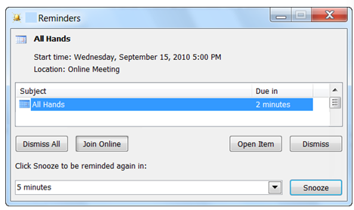
Join the Meeting
To join a meeting, choose one of the following methods:
In the Outlook invitation, click Join
online meeting or the meeting link.
If you have Microsoft Outlook ,
click Join Online in the Outlook
reminder.
Copy and paste the meeting link into
a browser window.
Join Online Meeting
BACK TO OBJECTIVES

Slide 20
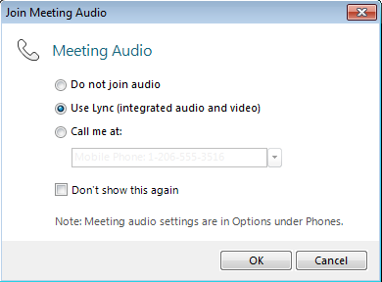
Select Your Meeting Audio
Choose one of the audio options below:
Do Not Join Audio: Select this option if you want to dial in to the meeting audio from a phone. using the conferencing numbers and the Conference ID. Please note that if you are dialing in as the leader or an authenticated caller, you will also need your PIN and extension number.
Use Lync (integrated audio and video): Select this option if you want to use computer audio. Make sure your microphone and speakers are working properly by using Audio Device Settings. In the meeting, click Settings on the menu bar, then Audio Device Settings.
Call me at: Select this option if you want to Lync to call you and log you into the meeting automatically. Using this option you will join the meeting using Lync, but will listen to the audio portion of the meeting on your phone. You do not need to enter a phone number or Conference ID.
BACK TO OBJECTIVES

Slide 21
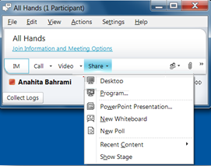
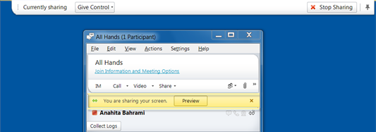
Share Your Desktop
After you login to the meeting, you can share your desktop or a program, deliver a PowerPoint presentation, insert a Whiteboard or Poll slide and add attachments among other options.
To share your desktop:
In your online meeting click Share.
On the Share drop down menu, click Desktop.
A bar is displayed at the top of the screen and a glow appears around the screen.
Click Stop Sharing to stop showing your desktop.
BACK TO OBJECTIVES

Slide 22
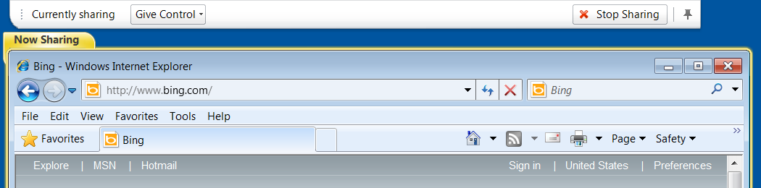
Share a Program
To share a program and the associated windows:
Click Share in your online meeting.
On the Share drop down menu, click Program.
Select the program you want to share.
A bar is displayed at the top of the screen, and a glow appears around the application window indicating what is being shared.
To stop sharing your application at any time, click Stop Sharing.
Stop Sharing
BACK TO OBJECTIVES

Slide 23
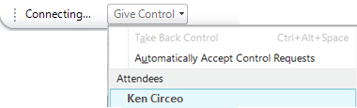
Give and Take Control of Your Sharing Session
When you start sharing, you’re the only one in control of what is being shown on the meeting stage. You can allow others to take control of your sharing session and you can take back control at any time.
Give Control
Click Give Control on the sharing bar at the top of the screen.
Click the name of an individual to share control with, then click OK on the confirmation box to proceed.
This person is now in control of your sharing session and can use their keyboard and mouse to control your shared content. The option to Release Control also becomes available on their Online Meeting toolbar.
To take back control click Take Back Control on the Give Control menu.
Give Control
BACK TO OBJECTIVES

Slide 24
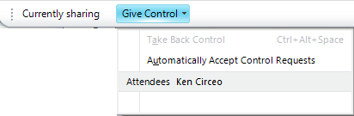
Request Control of a Sharing Session
Participants can request control of your sharing session at any time and you will receive a notification to Accept or Decline the request. You can allow all participants to take control of your sharing session automatically using the following steps:
On the sharing bar at the top of the screen, click Give Control, then click Automatically accept control requests. Click OK.
The option to Request Control is available to all meeting participants and
requests are automatically accepted.
You can deselect the option at any time using the commands on the Give Control menu. Participants also have the option to release control.
Note: Only one person can be in control at a time.
BACK TO OBJECTIVES

Slide 25
Deliver a PowerPoint Presentation
To deliver a PowerPoint presentation:
Click Share in your meeting.
Click Share and click PowerPoint Presentation.
Double click the PPT file you want to share.
The slides will be shown in the Stage area.
To move the slides, use the arrows at the lower right corner of the meeting window.
Click Show Presenter Notes to see your notes.
To show the thumbnails, click the Show Thumbnails icon.
Use the controls at the bottom of your meeting to annotate on the slides, use a laser pointer, insert an image, etc.
To stop showing the PowerPoint presentation, click Stop Presenting.
Show Presenter Notes
Annotation Tools
Show Thumbnails
BACK TO OBJECTIVES

Slide 26
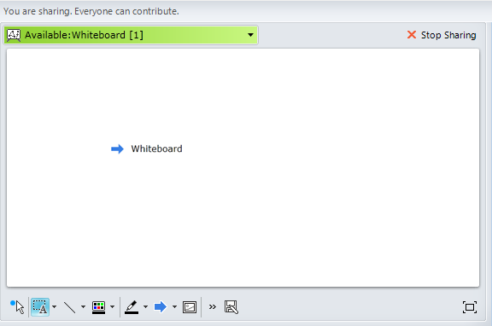
Insert a Whiteboard
Use the whiteboard to post a note to everyone in the meeting or use as a fresh page on which to brainstorm. Everyone in the meeting can write and draw on the whiteboard.
Click Share in your meeting.
On the Share drop down menu,
click New Whiteboard.
A whiteboards page will be inserted
in the Stage area.
To start writing or drawing on the
whiteboard, use the tools on the
bottom of the meeting.
Click Stop Sharing when you are done.
BACK TO OBJECTIVES

Slide 27
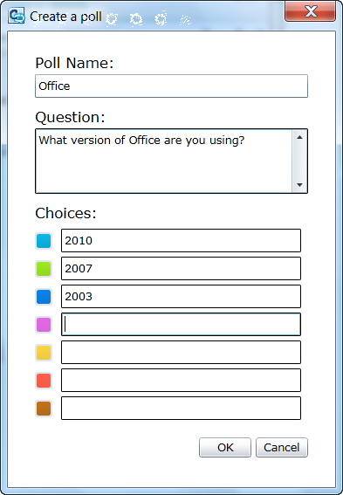
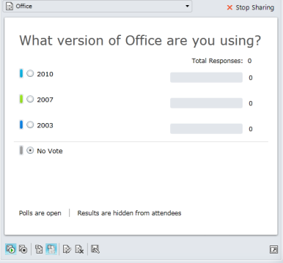
Insert a Polling Slide
To create a Poll slide in your meeting:
Click Share in your meeting.
On the Share drop down menu, click New Poll.
Type a name for the poll page, a question and the choices.
Click OK when you are done.
A Poll page is inserted in the Stage area of your meeting, and the participants can click the options to answer your question.
Use the control buttons at the bottom of the poll page to mange the poll page, such as open, close, show or hide results.
BACK TO OBJECTIVES

Slide 28
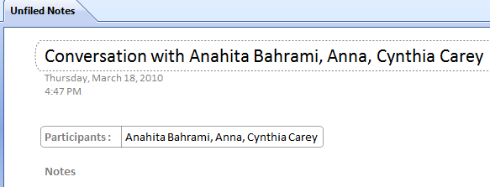
Take Meeting Notes with OneNote
Use Microsoft OneNote to take notes in your meeting. The names of the meeting participants will be automatically pulled from the meeting and saved in OneNote.
On the Online Meeting toolbar, click Actions.
Note: If you don’t see the toolbar, press the Alt key on your keyboard to activate the toolbar.
Click Take Notes Using OneNote.
OneNote opens and you can type your meeting notes.
A list of the meeting participants is also automatically inserted in OneNote.
BACK TO OBJECTIVES

Slide 29
Add Video to Your Meeting
Add video to your meeting:
Set up your Webcam per the device instructions.
Click the Video drop down menu, and then click Video Device Settings.
Configure your Webcam settings as appropriate, then click OK.
On the Video menu, click Add Video. Your video will be shown to all participants in the meeting.
Right click the video and use the menu to perform the following commands as appropriate: Pause My Video, Hide My Preview, Expand My
Preview, Pop Out Video, View Full Screen and
Video Device Settings.
Note: After performing any of the tasks above, you can right click the video again to undo the command. For example, after pausing your video, right click the video again and click Start my video to show your video.
You can also use the controls at the top of the video to pause your video, go to full screen, pop out your video, etc.
BACK TO OBJECTIVES

Slide 30
Add or View Attachments
To add a file to your meeting, such as a hand out or your presentation for the participants to download:
Click the Add or view attachments button.
In the Attachments dialog, click Add Attachments.
Select the file that you want to upload and then click Open.
By default everyone in the meeting can save the attachment locally. To control access, click the arrow next to the file, point to Make Available to and choose one of the following: Meeting Organizer, Presenters, Everyone. You can change the access level anytime during the meeting.
Tip: To keep your participants focused on your presentation and avoid distraction, you can restrict access to Organizer or Presenters at the beginning of the meeting and make the file available to Everyone after your presentation ends.
Participants in the meeting can click the Add or View Attachment button and then click the file to download it locally.
BACK TO OBJECTIVES

Slide 31
Record a Meeting
Record a meeting:
Click the More Options button in your meeting and then click Start Recording.
The Pause and Stop commands become available at the bottom of the meeting window.
Click the Stop button and customize the options on the Stop Recording window if needed.
By default, Lync saves your recordings in Lync recording format in the location: C:\Users\username\LyncRecordings. Click Browse… to save your recording to a different location.
By default the option to save the recording in (.wmv) format is also enabled. If not, check Also create a version that you can publish to others (.wmv) box. This option saves your recording in a single .wmv video format, which you can send to others.
BACK TO OBJECTIVES

Slide 32
View Your Recording
View your recording:
Click Start, All Programs, Microsoft Lync, and then click Microsoft Lync Recording Manager.
  Tip: You can also access the Recording Manager from Lync . Click Tools on the menu bar, then click Recording Manager.
In the Recording Manager window, select if you want to view the recording in Lync Recording format or Windows Media Recordings format. Click the appropriate tab at the top of the Recording Manager window.
Select a recording, and then click Play.
If you have selected the Windows Media Recordings format, the recording will play in Windows Media Player. If you have selected the Lync format, the recording will play in Lync Recording Playback.
BACK TO OBJECTIVES

Slide 33
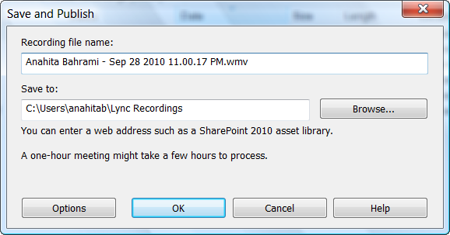
Share Your Recording
Share your recording with others:
Open the Recording Manager and click the Windows Media Recordings tab.
Select your recording, then click Browse to navigate to the location your recording was saved.
Copy the file and post it where others can access.
If you have saved your recording only in the Lync Recording format
and want to have a WMV version as well, follow the steps below:
  Click the Lync Recording tab.
  Select your recording, then click Publish.
  In the Save and Publish window, change the
  name and path of the recording if you want, and
  click OK.
  In the Save and Publish window, change the name
  and path of the recording if you want, and click OK.
TIP: You can also publish the recording directly to a location accessible to others, such as a team SharePoint.
BACK TO OBJECTIVES

Slide 34
Activity 3
Share your desktop and applications
Click Join online meeting to log in to your meeting.
On the Share drop down menu, click Desktop.
Note the sharing bar at the top of the screen and the gold bar in your meeting notifying you for your sharing status. Click Preview to open the stage area. Click Stop Sharing on the sharing toolbar.
On the Share drop down menu, click Program.
Select a program to share. Note the sharing bar and the notification in your meeting.
Click Stop Sharing.
BACK TO OBJECTIVES

Slide 35
Activity 4
Deliver a PowerPoint presentation
On the Share drop down menu, click, PowerPoint Presentation.
Select the PowerPoint file, and click Open.
Use the tools at the bottom of the screen to move the slides or annotate on your PowerPoint slides.
Click Stop Sharing.
BACK TO OBJECTIVES

Slide 36
Activity 5
Insert and use a Whiteboard
On the Share drop down menu, click New Whiteboard.
A Whiteboard page is inserted in your meeting.
Use the tools at the bottom of the screen to annotate on your Whiteboard.
Click Insert Image and select an image to insert on your Whiteboard.
Use the stamps button to insert Arrow, Check and X Stamps.
Click Stop Sharing.
BACK TO OBJECTIVES

Slide 37
Work with Anyone Anywhere
This section covers the following:
Collaborate with Your Contacts
Start an Unscheduled Online Meeting
Start an Unscheduled Conference Call
BACK TO OBJECTIVES

Slide 38
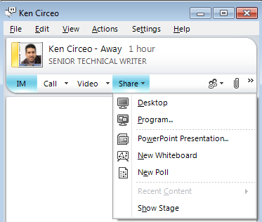
Collaborate with Your Contacts
You can use Lync to take advantage of the conferencing and collaboration features, without having to schedule an online meeting.
You can share your screen with a colleague in another location, deliver a PowerPoint presentation, or share ideas on the online whiteboard.
Double-click a contact’s name to open a
conversation window.
On the Share drop down menu, choose any of the presentation options:
  Desktop
  Programs
  PowerPoint Presentation
  New Whiteboard
  New Poll
You can use the collaboration features and Share options in the same way that you use with scheduled meetings.
BACK TO OBJECTIVES

Slide 39
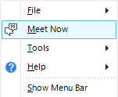
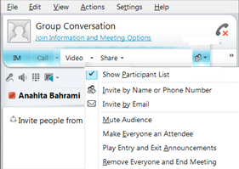
Start an Unscheduled Online Meeting
Use the Meet Now option to quickly start an impromptu online meeting and invite participants.
Open Lync , click the drop down menu next to the Options button, and then click Meet Now.
Select an Audio option and login to the meeting.
To invite participants, click the People Options drop down menu.
To add people within your organization and federated organizations, or invite someone by phone, click Invite by Name or Phone Number. You can also drag contacts from your contact list and drop in the meeting window.
To send an e-mail invitation to someone inside or outside your organization, click Invite by E-mail and send the Outlook invitation that opens automatically.
BACK TO OBJECTIVES

Slide 40

Start an Unscheduled Conference Call
Start an unscheduled conference call with multiple contacts
In the Contacts list, hold the CTRL key, and then select the contacts that you want to call.
Right-click the last contact’s picture or presence button, and then point to Start a Conference Call and click Lync.
Your contacts receive a conference invitation alert
that allows them to join your conference.
Conference invitation alert
Join an unscheduled conference call
If you have been invited to a conference call, click the conference invitation pop-up alert that appears in the lower-right corner of your computer and you’ll be added to the conference call.
BACK TO OBJECTIVES

Slide 41
Activity 6
Start an Unscheduled Online Meeting (Meet Now)
Open Lync , click the drop down menu next to the Options button, then click Meet Now.
Click the arrow next to People and then click Invite by Name or Phone Number.
Search for a contact or select from the list and click OK.
Your invitee will receive an alert and can join by clicking the pop up alert or Accept.
BACK TO OBJECTIVES

Slide 42
Microsoft® Lync™ 2010 Attendee
This section covers the following:
Understand Lync Attendee
Join a Meeting Using Lync Attendee
Set up Audio and Video
Lync Attendee Options
BACK TO OBJECTIVES

Slide 43
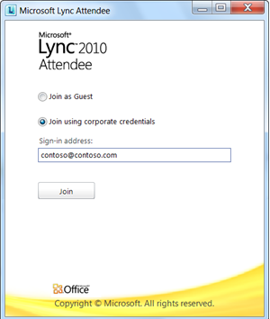
Microsoft Lync 2010 Attendee
Lync Attendee is a rich client that allows you to participate in online meetings. You won’t need Lync or an account on the server where the meeting will be hosted.
Features
Lync Attendee provides IM, audio, video, and all the data collaboration modalities while you are in the conference.
Interoperability
If both Lync Attendee and Communicator 2007 R2 are installed, the correct program for the meeting automatically opens when you join online meetings
BACK TO OBJECTIVES

Slide 44
Lync Attendee Requirements
If you’re running Windows, all that you need is Lync Attendee and the meeting link, which typically comes in an e-mail message from the organizer.
Lync Attendee automatically selects the best possible combination of device settings to use for the online meeting, or you can customize the settings.
When both Communicator 2007 R2 and Lync Attendee are installed, device settings that were changed and saved on one client will be saved on the other.
Lync Attendee may be installed on your computer by your organization, or you can download it from:
http://go.microsoft.com/fwlink/?LinkID=164090
BACK TO OBJECTIVES

Slide 45
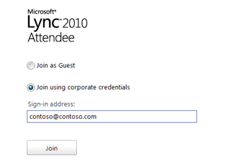
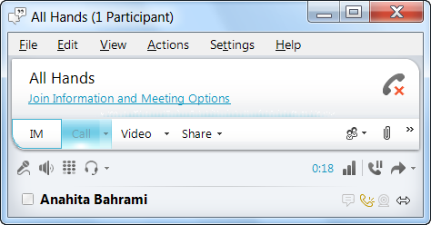
Join Using Your Corporate Credentials
If you want to use your Network credentials:
Click the meeting link in your invitation to open Lync Attendee sign-in window.
Select Join using corporate credentials.
In the Sign-in address box, type your email address as shown in the example.
Click Join.
Select an Audio option, and then click OK.
You’ll be logged into the meeting and can use audio, video, or IM to communicate with other participants.
BACK TO OBJECTIVES

Slide 46
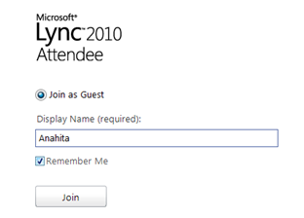
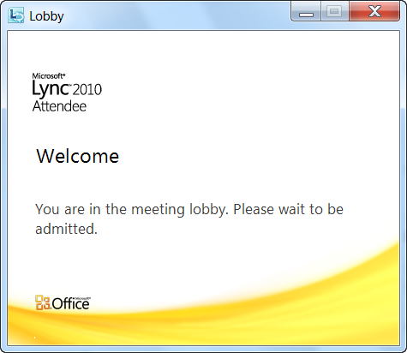
Join as a Guest
If you want to join as a guest:
On the login window, select Join as Guest.
Type your name as you want it to appear in the meeting, then click Join.
If the organizer has enabled the lobby, you’ll be directed to the meeting lobby until a presenter admits you in the meeting. Otherwise, you’ll be logged in automatically.
Lobby
BACK TO OBJECTIVES

Slide 47
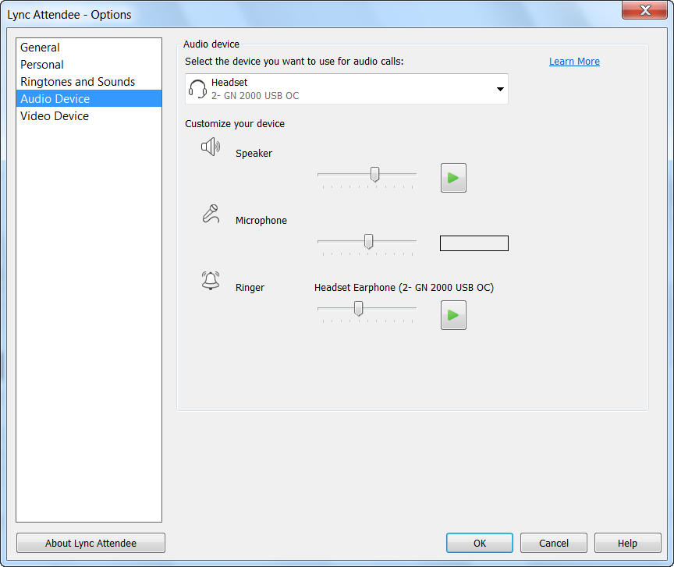
Access Audio and Video Options
Lync Attendee automatically configures the settings, depending on the device that you connect to.
Verify Audio Settings
On the toolbar, click Settings. If you do not see the toolbar, Press the Alt key on your keyboard to activate the toolbar.
Click Audio Device Settings.
In the Lync Attendee Options window, click the Audio Device tab.
BACK TO OBJECTIVES

Slide 48
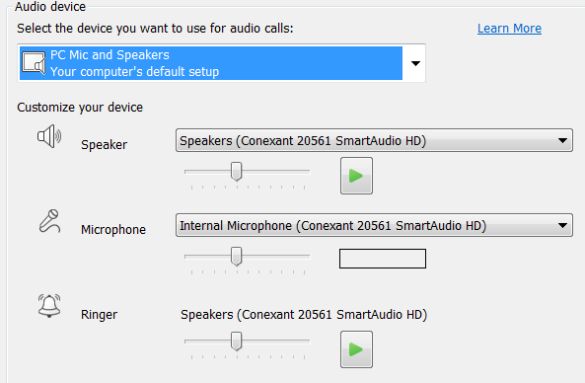
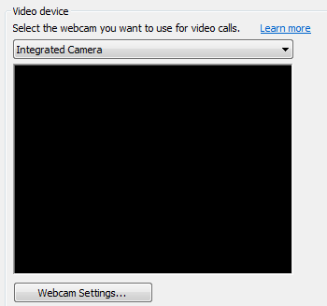
Set up Audio and Video
On the Audio Device tab, check your Speaker and Microphone and adjust as appropriate.
Click the Video Device tab, and then select the webcam you want to use.
Click Webcam Settings to adjust the options as appropriate.
Audio Device
Video Device
BACK TO OBJECTIVES

Slide 49
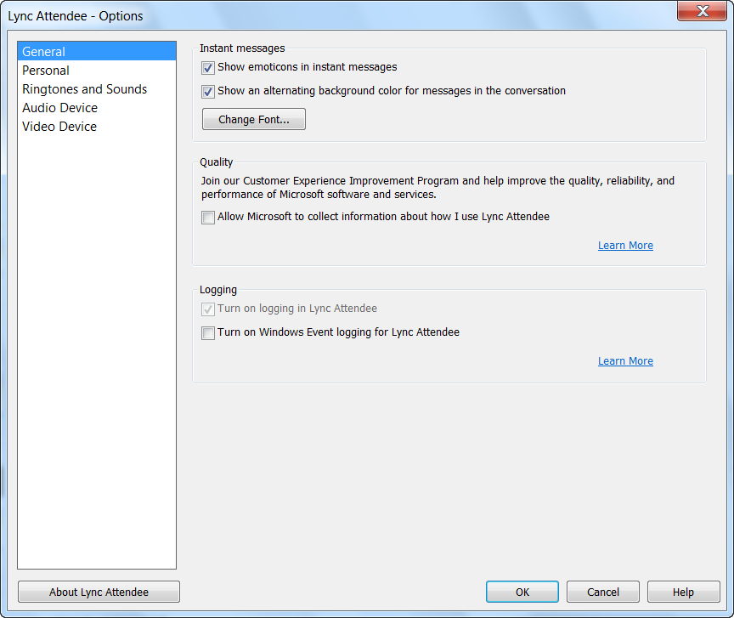
Lync Attendee Options
You can also review or modify Lync Attendee options before the meeting starts.
Click Start, and then click All Programs.
Click Microsoft Lync Attendee.
In the Attendee Lync Options window, review and modify any of the options as appropriate.
BACK TO OBJECTIVES

Slide 50
Review
This training course covered the following topics:
Get Set up for Online Meetings
Dial in conferencing and Personal ID
Schedule an Online Meeting
Multiparty/multi-platform meetings using Lync and Outlook
Deliver a Professional Presentation
Formal presentations using Screen Sharing, PowerPoint, and Whiteboard
Work with Anyone Anywhere
Collaboration with colleagues no matter where they are
Use Microsoft Lync Attendee
Join online meetings even if you don’t have Lync installed

Slide 51


© 2010 Microsoft Corporation. All rights reserved. Microsoft, Exchange ActiveSync, Excel, Lync, Outlook, PowerPoint, SharePoint, SQL Server, Windows, Windows Live, Windows Mobile, Windows Server, and other product names are or may be registered trademarks and/or trademarks in the United States and/or other countries/regions. The information herein is for informational purposes only and represents the current view of Microsoft Corporation as of the date of this presentation. Because Microsoft must respond to changing market conditions, it should not be interpreted to be a commitment on the part of Microsoft, and Microsoft cannot guarantee the accuracy of any information provided after the date of this presentation. MICROSOFT MAKES NO WARRANTIES, EXPRESS, IMPLIED OR STATUTORY, AS TO THE INFORMATION IN THIS PRESENTATION.
BACK TO OBJECTIVES

